Slide 1
pea 516
Lecture-9
Boats & streams and races

Slide 2
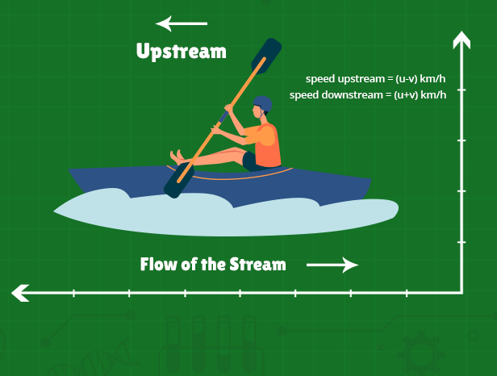
Contents:
Concept of downstream and upstream
linear and circular track problems

Slide 3
Boats and Streams
General terms:
1) Still water: The water of a river or any other water body which is not flowing is known as still water.
2) Stream: It is the flowing water of a river which is moving at a certain speed.
3) Upstream: The boat or a swimmer moving against the stream is known as moving upstream i.e. against the flow of water.
4) Downstream: The boat or a swimmer moving along the stream is known as moving downstream i.e. along the flow of water.

Slide 4
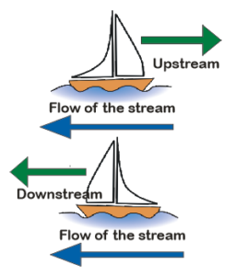
Boats and Streams
Upstream | (u−v) km/hr
Downstream | (u+v)Km/hr
Speed of Boat in Still Water | ½ (Downstream Speed + Upstream Speed)
Speed of Stream | ½ (Downstream Speed – Upstream Speed)

Slide 5
1) A boat can travel with a speed of 13 km/hr in still water. If the speed of the stream is 4 km/hr, find the time taken by the boat to go 68 km upstream.
2 hours
3 hours
4 hours
7.5 hours

Slide 6
2) Ravi can row upstream at 9 km/h and downstream at 15 km/h. Find the Ravi’s speed in still water?
A]12
B]11
C]13
D]14

Slide 7
3) A boat goes 13 km upstream in 39 minutes. The speed of stream is 3 kmph. The speed of boat in still water is?
27 kmph
23 kmph
25 kmph
None

Slide 8
4) A boat running downstream covers a distance of 16 km in 2 hours while for covering the same distance upstream, it takes 4 hours. What is the speed of the boat in still water?
4 km/hr
6 km/hr
8 km/hr
Data inadequate

Slide 9
5) A man can row upstream 18 km and 36 km downstream each in 6 hrs. The speed (in kmph) of the current is?
A]2
B]1.5
C]3
D]4

Slide 10
6) The speed of a boat in still water in 15 km/hr and the rate of current is 3 km/hr. The distance travelled downstream in 12 minutes is:
2.4 km
1.5 km
3.6 km
5 km

Slide 11
7) A boat is moving 2 km against the current of the stream in 1 hour and moves 1 km in the direction of the current in 10 minutes. How long will it take the boat to go 5 km in stationary water?
1 hr 20 minutes
1 hr 30 minutes
1 hr 15 minutes
30 minutes

Slide 12
8) Find the average speed of a boat in a round trip between two places 25 km apart. If the speed of the boat in still water is 10km/h and the speed of the river is 5 km/h?
7.5
8.25
9.5
None of these
Notes:
Ans: 92.86 miles/hour

Slide 13
9) A person can swim in water with a speed of 13 km/hr in still water. If the speed of the stream is 4 km/hr, what will be the time taken by the person to go 68 km downstream?
2.5 hours
3 hours
4 hours
3.5 hours

Slide 14
10) A motorboat, whose speed in 15 km/hr in still water goes 30 km downstream and comes back in a total of 4 hours 30 minutes. The speed of the stream (in km/hr) is:
4
5
6
10

Slide 15
11) A boat takes 90 minutes less to travel 36 miles downstream than to travel the same distance upstream. If the speed of the boat in still water is 10 mph, the speed of the stream is:
2 mph
2.5 mph
3 mph
4 mph

Slide 16
12) A jogger running at 9 km/hr along side a railway track is 260 m ahead of the engine of a 140 m long train running at 45 km/hr in the same direction. In how much time will the train pass the jogger ?
A) 25 sec
B) 40 sec
C) 38 sec
D) 32 sec

Slide 17
13) A man can row 6 kmph in still water. If the river is running at 3 kmph, it takes 3 hours more upstream than to for downstream for the same distance. How far is the place?
24 km
36 km
28 km
None

Slide 18
14) The ratio of the speed of the boat in downstream to upstream is 7: 4. A boy takes 4 hours to cover the total distance of 88km upstream. What is the speed of the boat in still water?
A] 30.25 Kmph
B] 35 Kmph
C] 20.15 Kmph
D] 15 Kmph

Slide 19
RACE
15) In a race of 1500m, H beats Q by 195 m or 15 seconds. Find Q’s speed
A. 5
B. 10
C. 13
D. 20

Slide 20
16) In a 400 m race, A can give B 30 m and C 50 m start . In the same race B can give to C a start of(approx)
A.21m
B.28m
C.30m
D.40m

Slide 21
17) A and B take part in 500 m race. A runs at 10 m/s. A beats B by 5 seconds. The speed of B is:
A. 9.09 m/s
B.11 m/s
C.12.12m/s
D.1.8m/s

Slide 22
18) In a 1800 m race, the ratio of the speeds of two contestants W and F is 7: 9. W has a start of 330 m. Then, F wins by?
A.50
B.90
C.150
D. 200

Slide 23
19) A runs 3 times as fast as B. If A gives B a start of 45 m, how far must the winning post be so that A win by 15 meter?
A.80m
B.120m
C.135m
D. None

Slide 24
20) Three runners participated in a Circular Race, completes the race in 12 sec, 15 sec and 20 sec respectively. if all the three starts at the same time and the same point then find when all will meet at the first time at starting point?
A.120sec
B.80sec
C.60sec
D.160sec

Slide 25
21) Raju, Ketan and Ritu run around a circular track of length 2400 m with respective speeds 9, 18, 27 kmph. If they started at the same time from the same point and run in the same direction when will they meet for the first time?
A.360 sec
B.480 sec
C.960 sec
D. None

Slide 26


